Slide 1
Dice roller
Project Created By: MANVI PATEL Type: Desktop GUI application Institution: [VIT BHOPAL]

Slide 2
INTRODUCTION:
Dice Roller is a fun single-player game that I created using Python. It's basically an interactive dice rolling game where you can keep rolling the dice as many times as you want. The game doesn't just show you what number you rolled, it also keeps track of your statistics like total rolls, best roll, and encourages you with messages like "Good luck!" or "Better luck next time!"
I got the idea for this project because I wanted to make something more than just a basic dice roller. Instead of just showing random numbers, I added a gaming element to it with score tracking and motivational messages. This makes it more engaging and fun to use. It's like having a digital dice game that remembers all your rolls and cheers you on.

Slide 3
OBJECTIVES:
When I started building this game, these were my main goals:
Create an interactive dice rolling game that's actually fun to play
Learn how to track and store multiple data points like total rolls and best score
Make the game feel alive with encouraging messages
Practice using variables to store game statistics
Understand how to keep the game running infinitely until user quits
Make something I could show to my friends and actually play with them
Basically, I wanted to build something that was both educational for me and entertaining for users.

Slide 4
METHODOLOGY:
Here's how I built this game step by step:
First, I researched about the random module in Python and how to generate random numbers. Then I planned what features I wanted - not just rolling, but also tracking statistics. After that, I started coding the basic dice roll function. Once that worked, I added variables to track total rolls and best roll. Then I added the motivational messages to make it more fun. Finally, I tested it multiple times to make sure all the statistics were updating correctly.
The trickiest part was keeping track of all the statistics while the game runs. I had to use variables properly and update them after each roll. I also spent time thinking about what messages would make the game more enjoyable. It took me around a week to complete because I kept adding small improvements.

Slide 5
HOW THE GAME WORKS:
When you start the game, it welcomes you and explains that you can roll the dice as many times as you want. Each time you press 'r' to roll, the game generates a random number between 1 and 6.
But here's where it gets interesting - the game keeps track of everything. It counts how many total rolls you've made. It remembers your best roll (highest number you got). After each roll, it shows you the current number, your total rolls so far, and your best roll till now.
The game also encourages you with random messages. Sometimes it says "Good luck!" before a roll, or "Better luck next time!" if you get a low number, or celebrates when you get a high number. This makes it feel less robotic and more like a real game.
You can keep playing infinitely until you press 'q' to quit. When you quit, it shows you your final statistics - total rolls you made and what was your best roll throughout the session.

Slide 6
CODE STRUCTURE AND FEATURES:
My code is organized into these main parts:
Import Section: I imported the random module for generating dice numbers.
Variables: I created variables to store total_rolls (starts at 0) and best_roll (starts at 0). These update after every roll.
Dice Roll Function: This generates a random number from 1 to 6 using random.randint(1, 6).
Message Function: I made a small function that randomly picks encouraging messages to display.
Main Game Loop: This is a while loop that keeps running until the user quits. Inside this loop:
Takes user input (r or q)
If 'r', rolls the dice
Updates total rolls count
Checks if current roll is better than best roll
Displays the result with current statistics
Shows a random encouraging message
If 'q', displays final stats and exits
Display Stats: After each roll, it clearly shows your current roll, total rolls, and best roll so you always know how you're doing.

Slide 7
GAME FEATURES:
Here's everything my dice roller game can do:
Infinite Rolling: Roll the dice as many times as you want, no limit
Statistics Tracking: Keeps count of total number of rolls you've made
Best Roll Memory: Remembers and displays your highest roll
Motivational Messages: Shows encouraging texts like "Good luck!", "Better luck next time!", "Great roll!", etc.
Real-time Updates: Shows updated statistics after every single roll
Single Player: Easy solo game, no need for opponents
Final Summary: When you quit, shows your complete game statistics
Simple Controls: Just press 'r' to roll and 'q' to quit

Slide 8
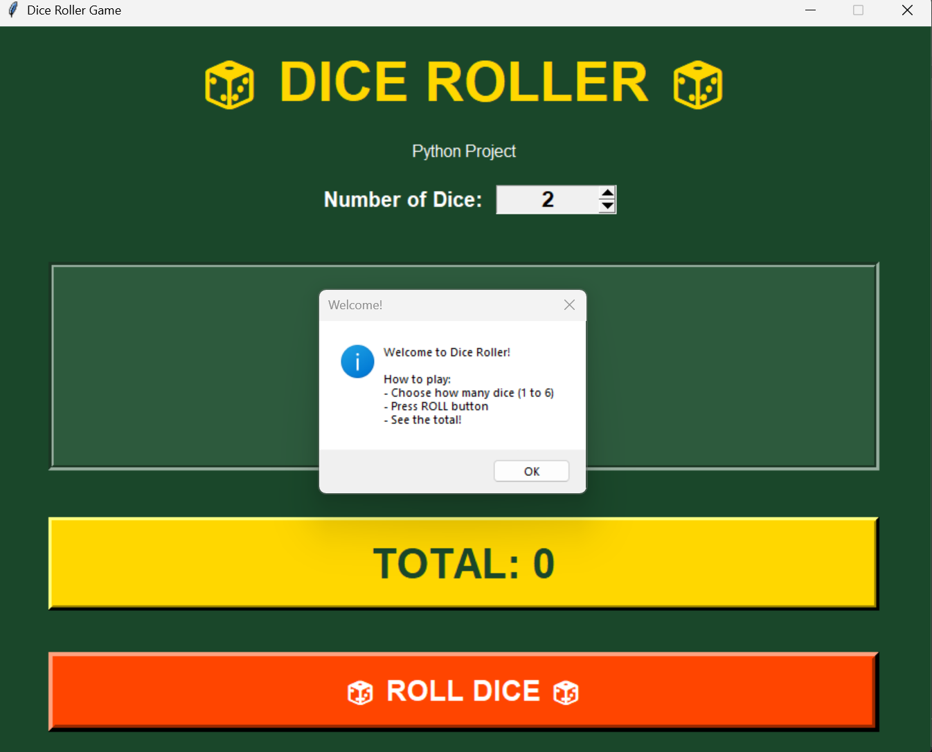
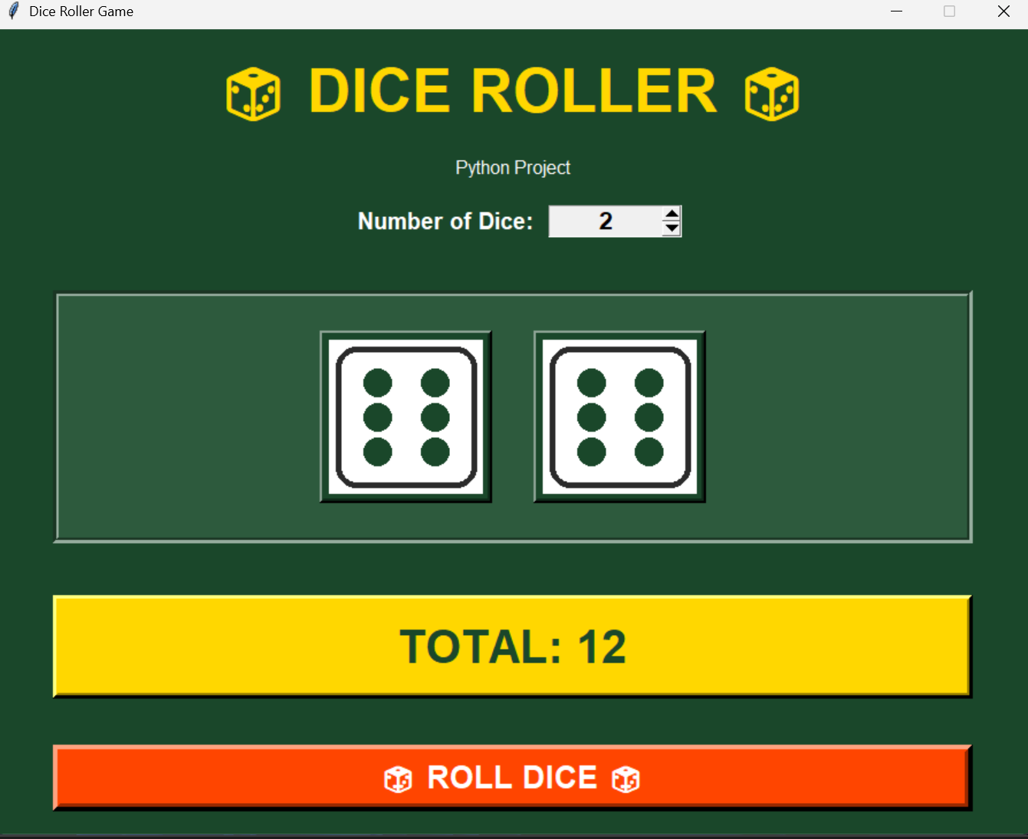
SAMPLE OUTPUT:
This is what the game looks like when you play:

Slide 9
ADVANTAGES:
Making and playing this game has several benefits:
Fun to Play: The messages make it entertaining, not boring
Tracks Progress: You can see how many times you rolled and your best score
Learn Statistics: Helps understand concepts like tracking maximum values
Motivational: The encouraging messages make you want to keep playing
No Physical Dice Needed: Can play anywhere on your computer
Good Practice: Taught me a lot about variables, loops, and conditions
Shareable: Friends can play it too and compete for best scores
Replayability: Infinite rolls means you can play as long as you want

Slide 10
FUTURE ENHANCEMENTS:
If I work on this project again, I want to add:
Two Player Mode: Let two people compete and see who gets the best roll
Save Scores: Store game history in a file so you can see past records
More Messages: Add variety of encouraging and funny messages
Achievements: Like "Rolled 50 times!" or "Got three 6s in a row!"
Graphical Interface: Make it with Tkinter with buttons and dice images
Sound Effects: Add dice rolling sounds
Difficulty Levels: Maybe add challenges like "Get a 6 in 5 rolls"
Leaderboard: Top 10 best rolls or most rolls in a session
These would make the game even more addictive and fun!

Slide 11
CHALLENGES FACED:
While making this project, I faced some problems:
Tracking Statistics: Initially I struggled with updating the total_rolls and best_roll variables correctly. Sometimes they weren't updating or were updating at wrong times. I fixed this by carefully placing the update code after each roll.
Message System: Deciding when to show which message was confusing. I had to use if-else conditions to show different messages based on the roll value.
Testing: I had to play the game many times to make sure the statistics were accurate. Once I found a bug where best_roll wasn't updating, and I had to debug it.
User Experience: Making the output look clean and organized took some effort. I added emojis and proper spacing to make it visually appealing.
But solving these problems taught me a lot and made me a better programmer!

Slide 12
CONCLUSION:
Creating this Dice Roller Game was one of the most fun projects I've done. It started as a simple idea but I kept adding features to make it more interesting. The combination of random rolling, statistics tracking, and motivational messages makes it actually enjoyable to play.
I learned so much while building this - from using the random module to tracking multiple variables to making the user interface friendly. The best part was when I showed it to my friends and they actually wanted to play it and see who could get the highest roll!
This project proved to me that even simple ideas can be turned into engaging programs if you add the right features. It's not just about making code work, it's about making it fun and useful. I'm really proud of what I created and I definitely want to keep improving it.

Slide 13
LEARNING OUTCOMES:
Through this project, I learned:
How to use Python's random module effectively
Variable management and updating values
Creating infinite loops with proper exit conditions
Making programs interactive and user-friendly
Adding personality to programs with messages
Testing and debugging code
Thinking about user experience
How small features can make a big difference

